Slide 1



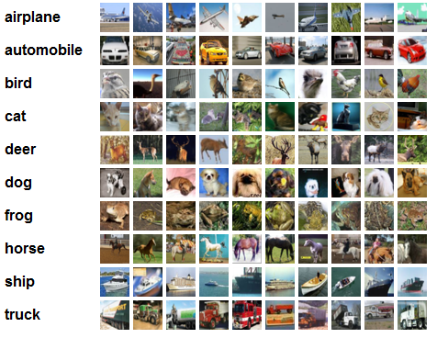
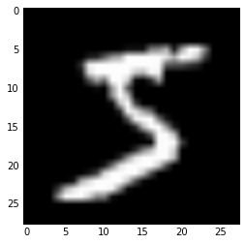






Deep Learning Project
Your names | MSiA 490-30 Deep Learning | Spring 2017 | Northwestern University
Problem Statement
Technical Approach
Results
Statement of the problem, why it matters and to whom
Explain why the problem is hard to solve, and why others haven’t adequately tackled this problem. Describe briefly the approaches already taken to solve the problem.
Describe the technical approach to your problem
Use diagrams to illustrate workflow
Step 1
Describe this step in your experiment
Step 2
Describe this step in your experiment
Step 3
Describe this step in your experiment
Step 4
Describe this step in your experiment
Include results based on your experiments
Where did the model perform well, where did it struggle?
Justify why you think your model made the right decisions using heatmaps or other ways to explain the model
What was the baseline human accuracy? Did the machine get anywhere near that? Why?
Justify why your approach is reasonable compared to alternate approaches
Dataset
Conclusion
Describe your dataset
Show some example data points
Explain how you cleaned the data
Note challenges in working with the data
Explain how much computation power was required to process the data
If applicable, explain how you augmented the data, e.g. shifting data, flipping, changing colors, etc
Was the dataset big enough, do you think overfitting is likely?
Show loss curve during training to see how well the network has learned
Brief summary of what you discovered based on results
Limitations of approach
How to improve/future work
Output
…
$$L_{1}$$
$$L_{2}$$
$$L_{3}$$
References and Related Work
Input
$$W_{1}$$
$$W_{2}$$
Output
Hidden L1
Hidden L2
$$W_{3}$$
Include print and electronic sources in alphabetical order

Slide 2
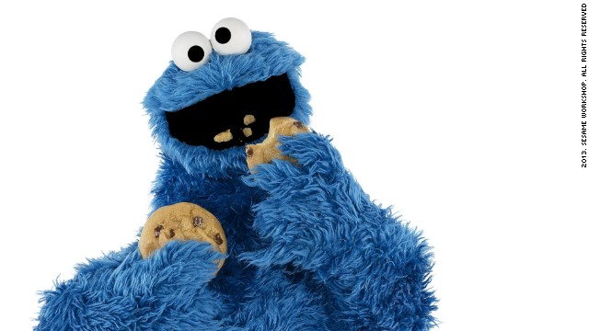



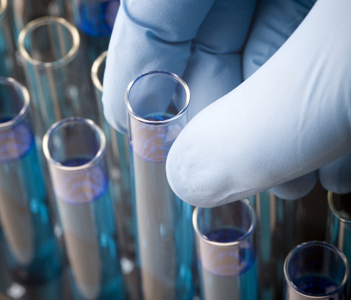
Convectional Neural Networks
Lydia Chang, Stephanie Ger, Ik-Hwan Kim, Craig Ng | MSiA 490-30 Deep Learning | Spring 2017 | Northwestern University
Problem Statement
Technical Approach
Results
Problem: build a model that can creatively generate new recipes
Difficulty: models are good at copying, but they are not good at generating
Other approaches: other models have too many different types of recipes (e.g., savory and dessert), char-level generation, but haven’t tried word- or ingredient-level
Created synthetic data by shuffling the ingredient list for each recipe (while retaining the same title) to try and combat dependencies on ingredient order
Prepended the title of the recipe to the beginning of the recipe (within brackets) and tab-separated it from the ingredient list, which is comma separated
PLACEHOLDER FOR HEATMAPS – include sample output with heatmap right below (one each for character, word and phrase-level networks)
Step 1
Step 2
Step 3
Step 4
Step 4
Preprocess the data
Prepend the titles
Create synthetic observations by shuffling ing
Train model on the processed data
Generate recipe by seeding model with created title in brackets
Include results based on your experiments
Where did the model perform well, where did it struggle?
Justify why you think your model made the right decisions using heatmaps or other ways to explain the model
What was the baseline human accuracy? Did the machine get anywhere near that? Why?
Justify why your approach is reasonable compared to alternate approaches
Dataset
Conclusion
Pulled 90k recipes from Yummly (a recipe repository) using their API and using ‘cookie’ as the search parameter
Removed any recipes that didn’t have cookie in the title
Created a dictionary of words by looking at the term frequency matrix of the corpus and removing any words that appeared less than 100 times (retaining 85% of the original corpus)
Inspected the final dictionary and removed any words that were instructions or were unrelated to cookies
Brief summary of what you discovered based on results
Limitations of approach
How to improve/future work
Output
…
$$L_{1}$$
$$L_{2}$$
$$L_{3}$$
References and Related Work
Input
$$W_{1}$$
$$W_{2}$$
Output
Hidden L1
Hidden L2
$$W_{3}$$
Include print and electronic sources in alphabetical order

